Slide 1

WAY TO ENTERPRISE
Advanced Java
VTI ACADEMY
Author: duy.nguyenngoc1@vti.com.vn
March 2020

Slide 2
Agenda
ModelMapper
Specification
HATEOAS
Assignments
Copyright © VTI Academy All Rights Reserved

Slide 3
ModelMapper
Used to automatically convert objects
Home page: http://modelmapper.org/

Slide 4
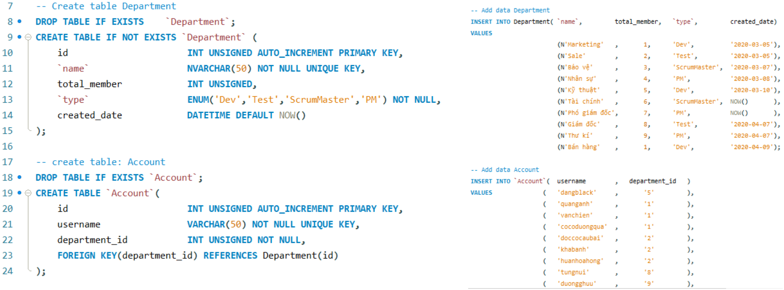
ModelMapper
Example
Repeat error

Slide 5
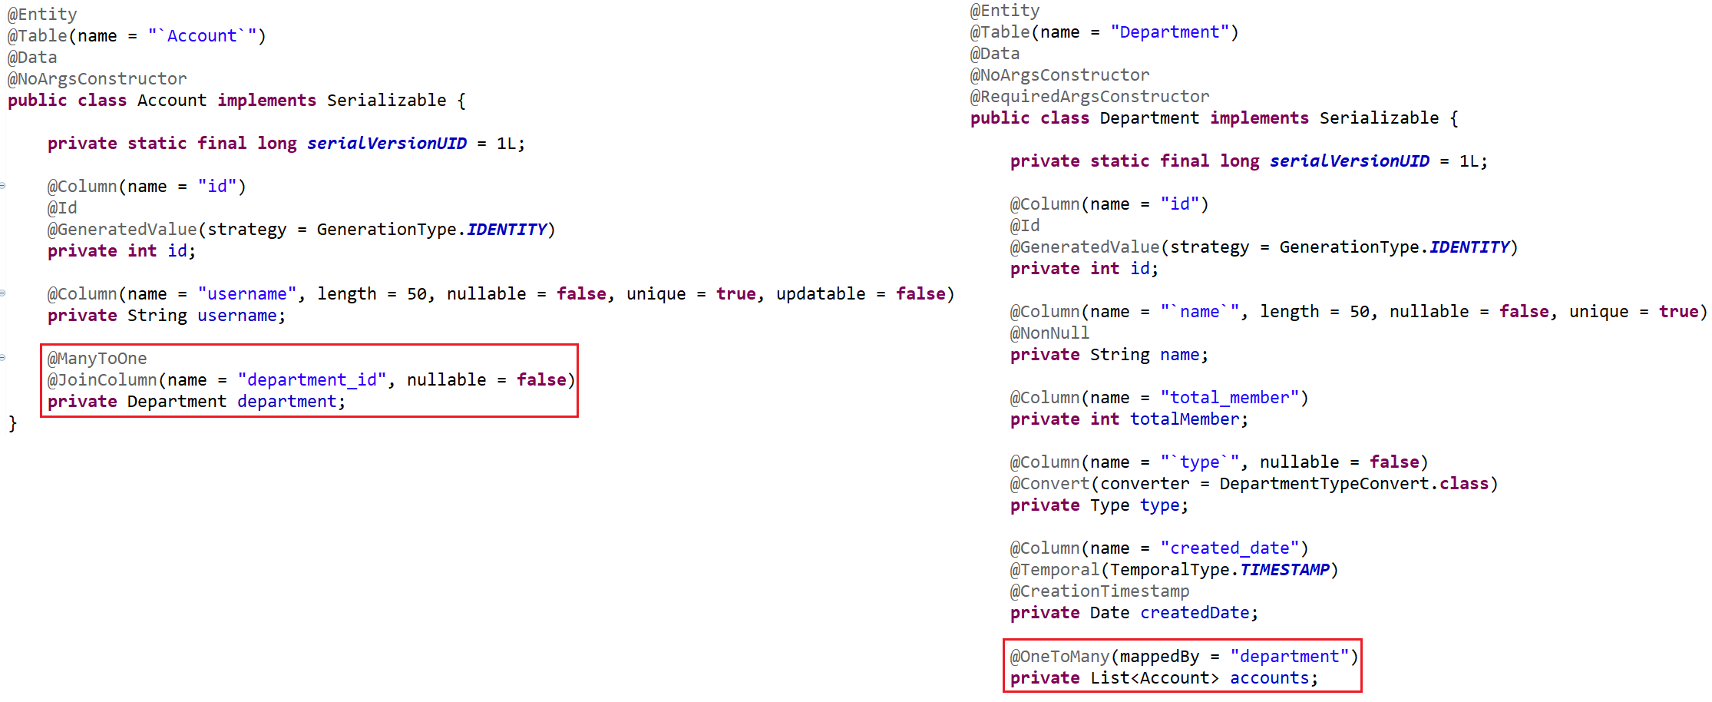
ModelMapper
Entity

Slide 6
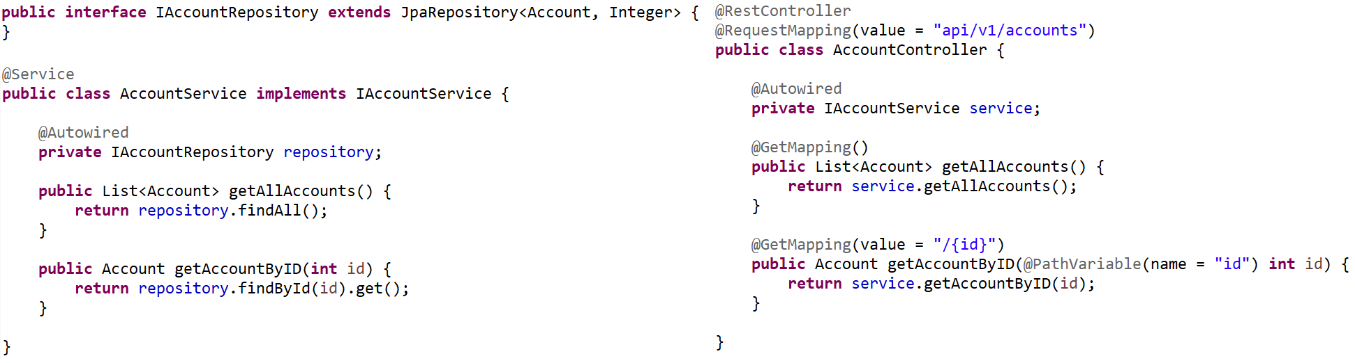
ModelMapper
Repository & Service & Controller

Slide 7
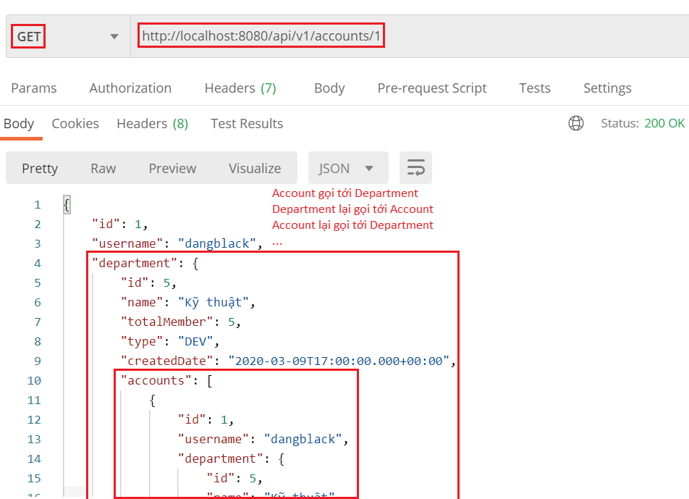
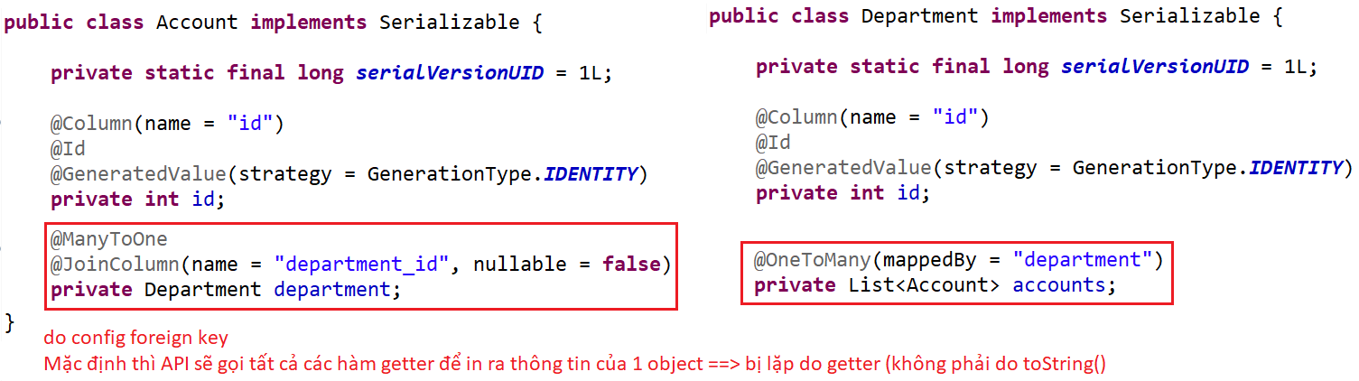
ModelMapper
Test

Slide 8
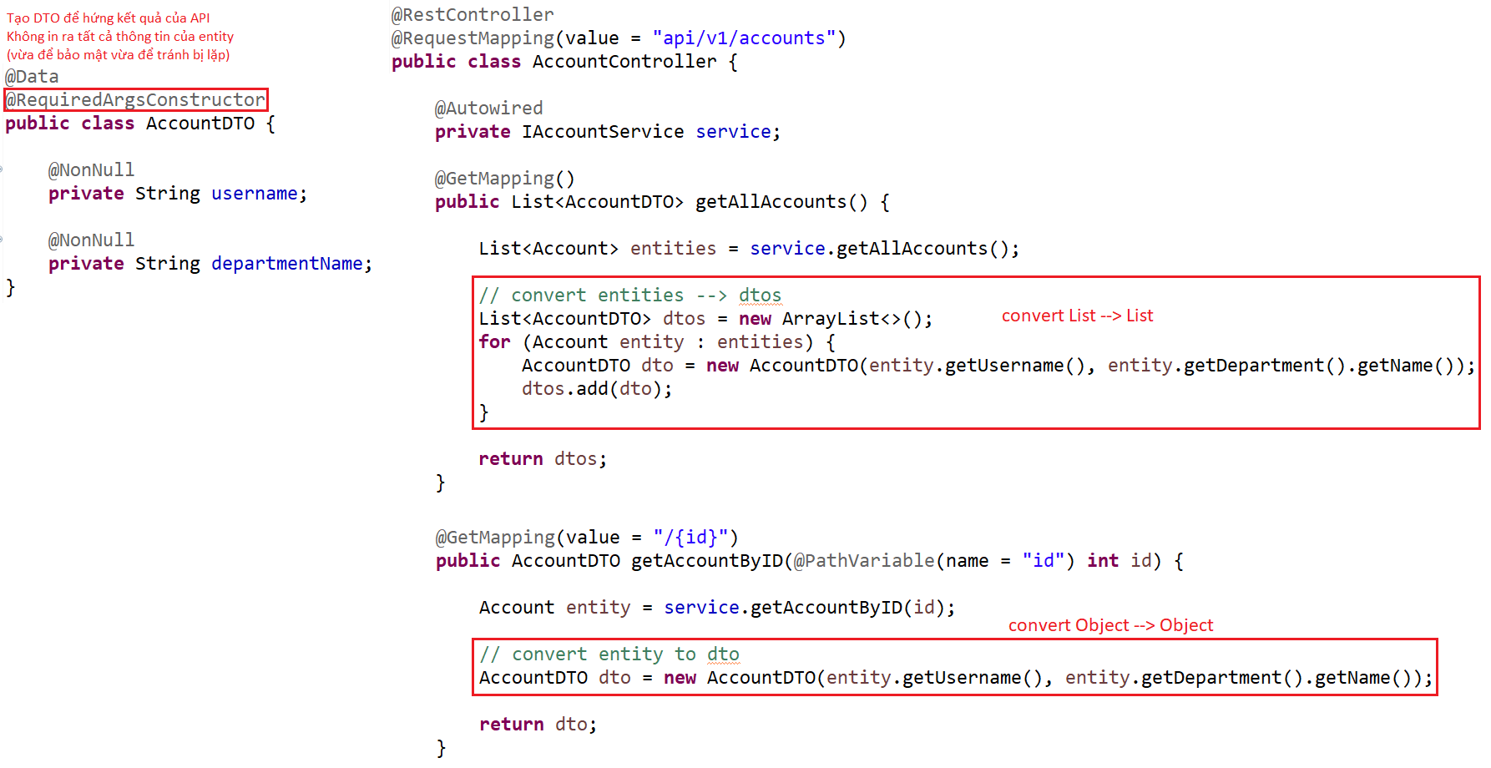
ModelMapper
Fix by DTO
DTO & Controller

Slide 9
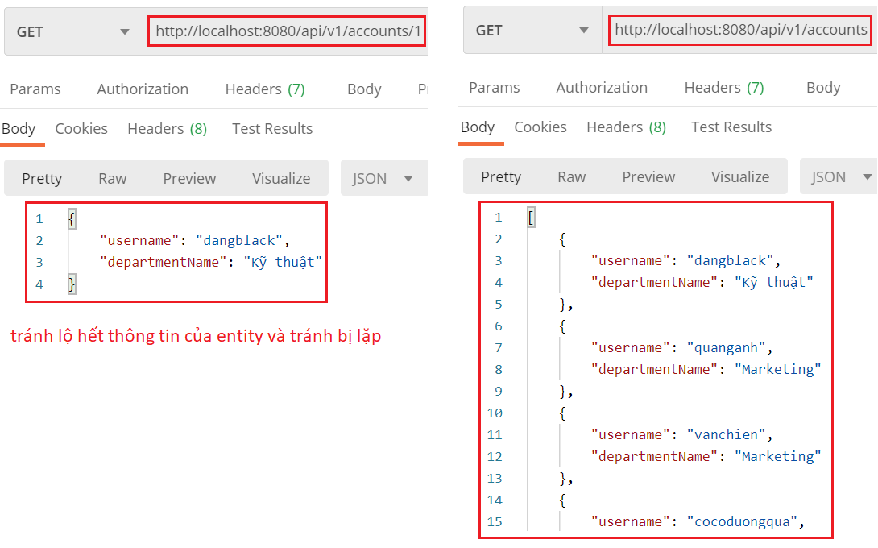
ModelMapper
Test

Slide 10
Testing System Assignments
Self-practice

Slide 11
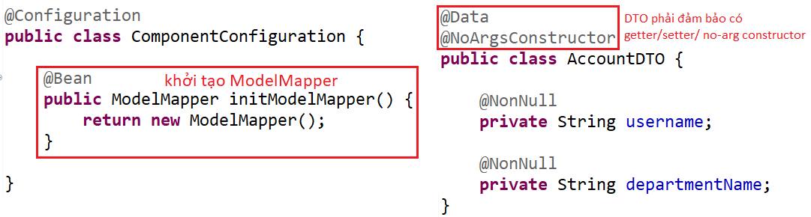
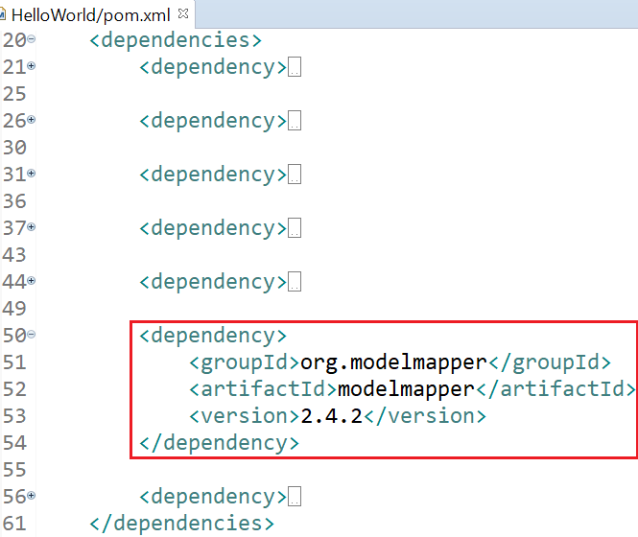
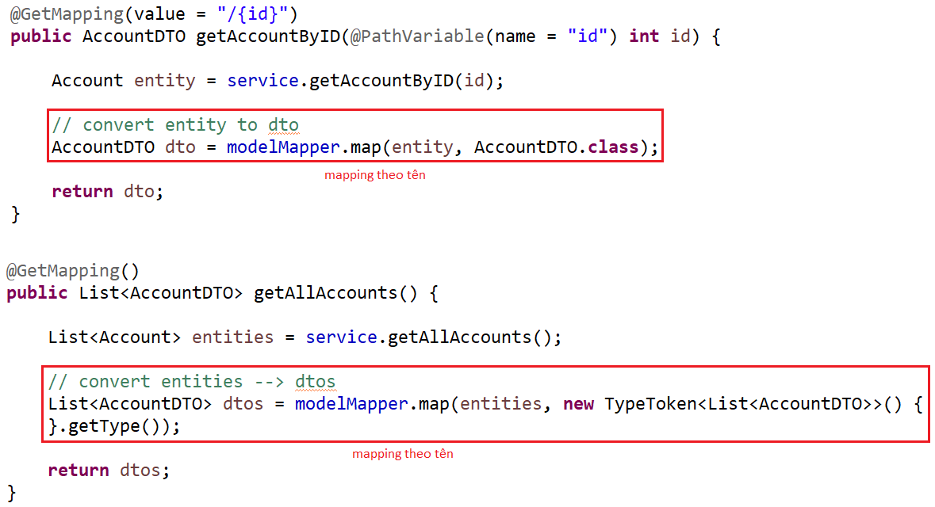
ModelMapper
Fix by ModelMapper
http://modelmapper.org/getting-started/
DTO & Controller

Slide 12
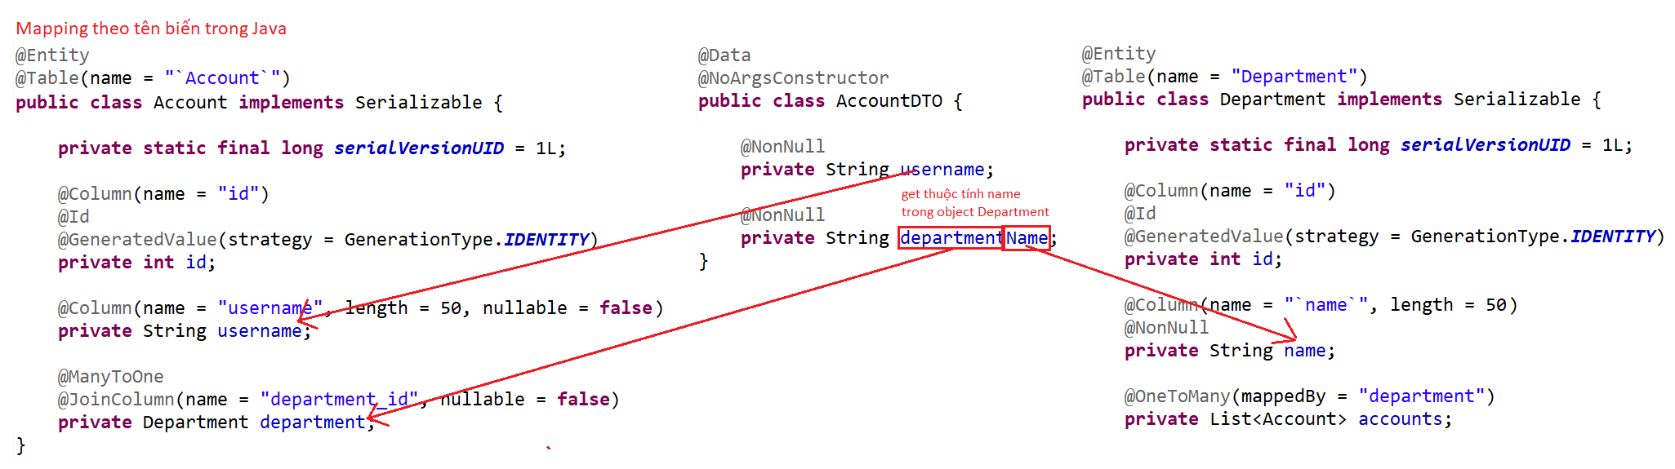
ModelMapper
Mapping Entity & DTO

Slide 13
Testing System Assignments
Self-practice

Slide 14
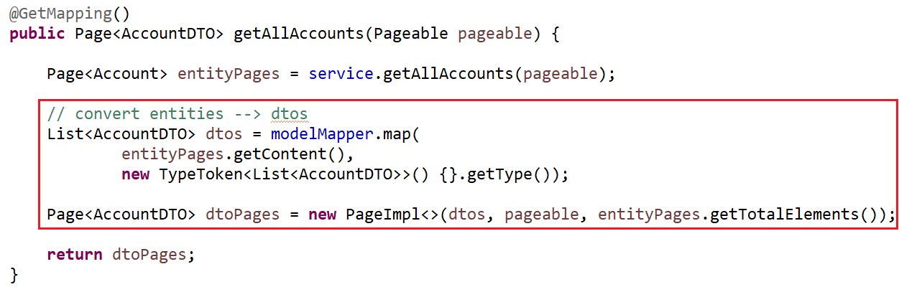
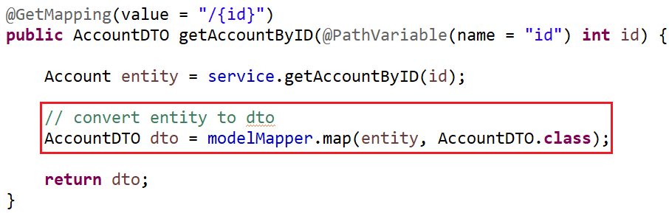
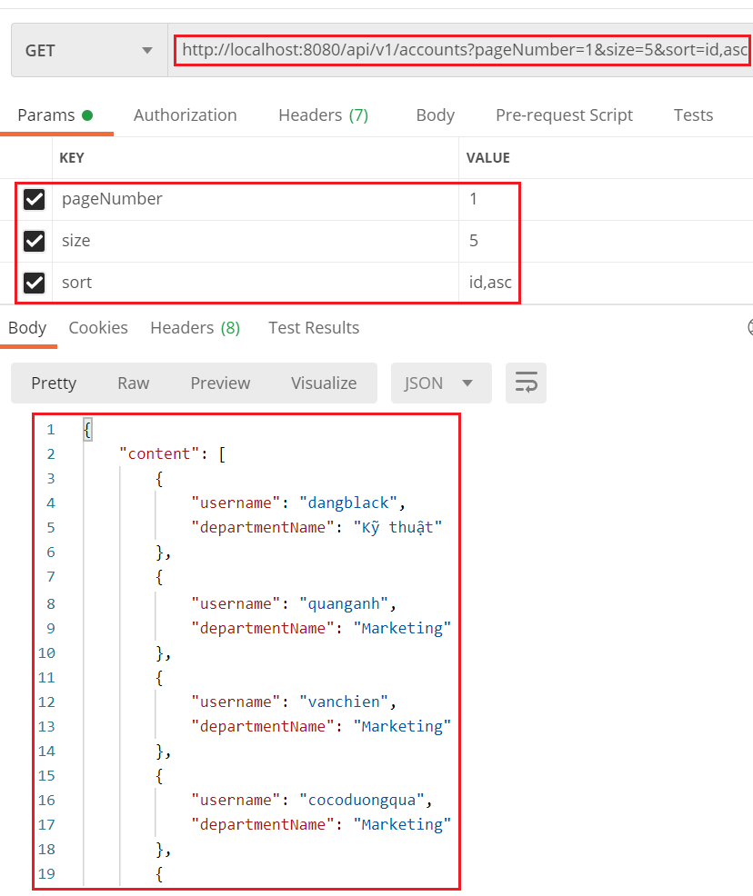
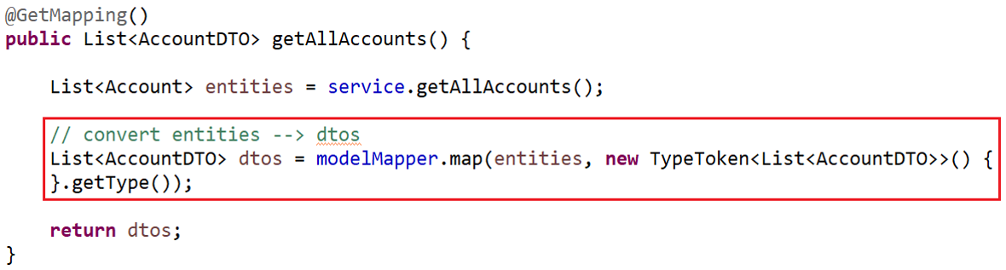
ModelMapper
Summary
Convert Object to Object
Convert List to List
Convert Page to Page

Slide 15
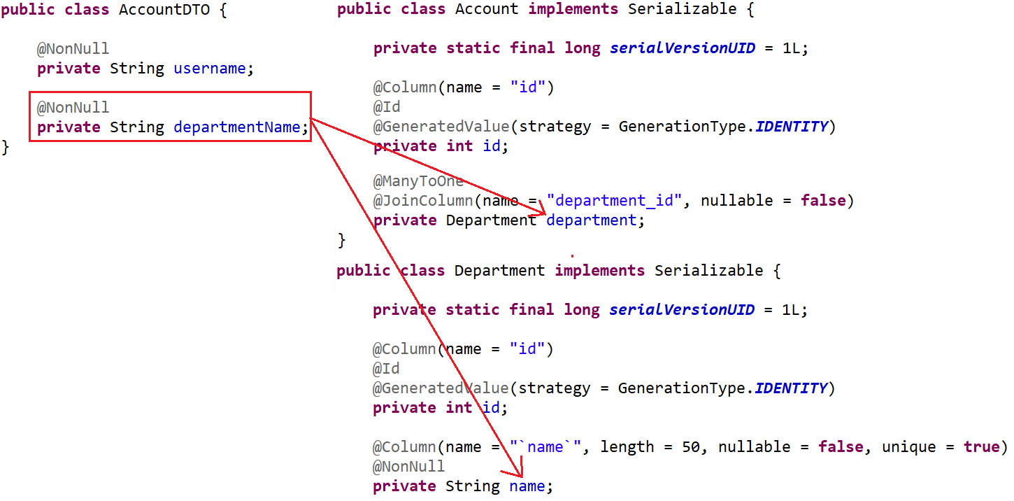
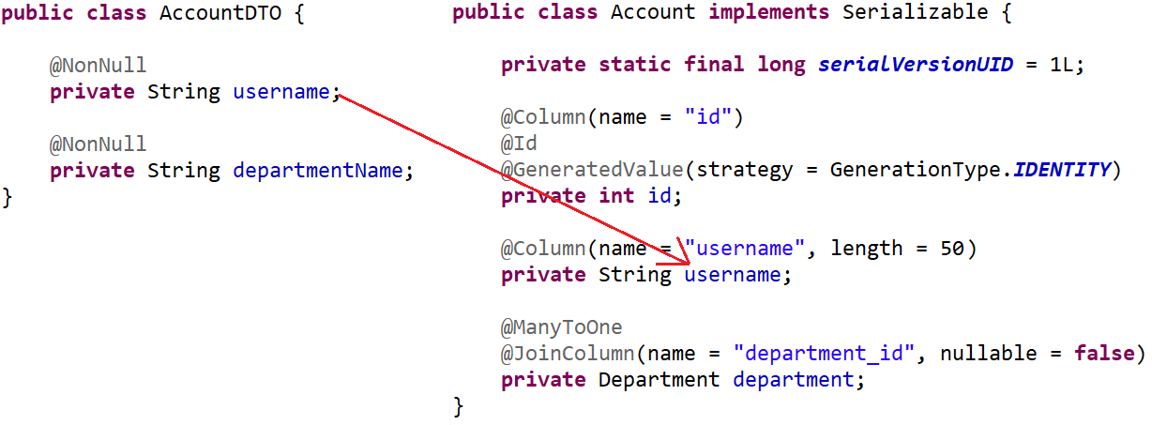
ModelMapper
Mapping
Mapping Attribute
Mapping Nested Attribute

Slide 16
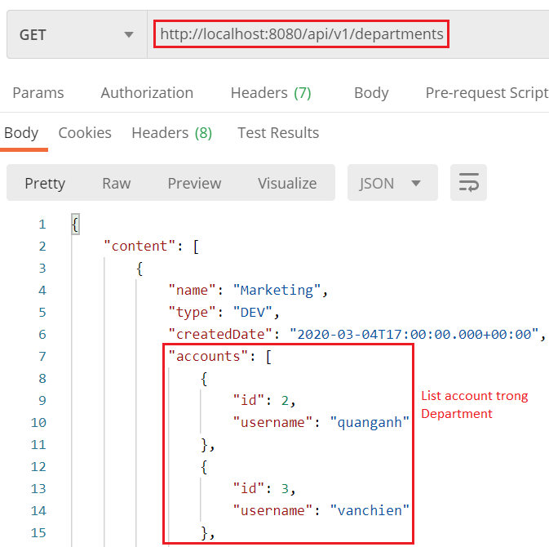
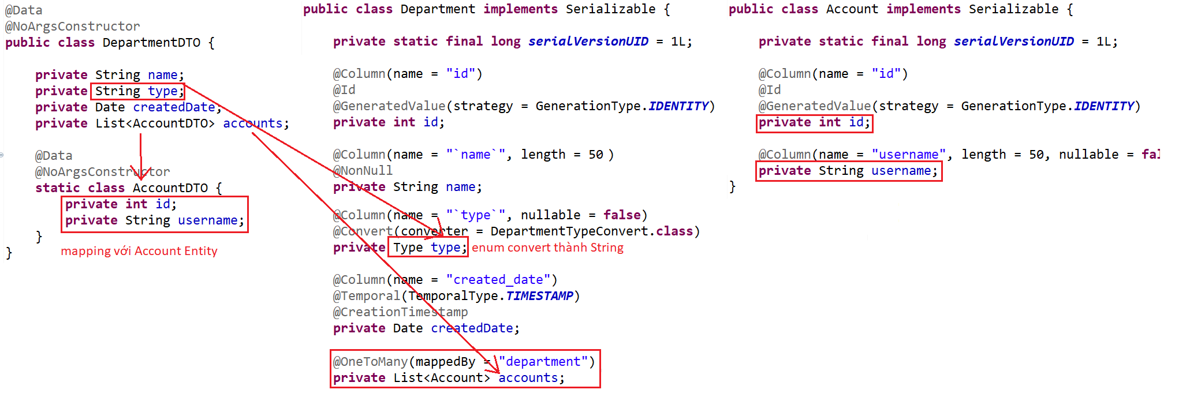
ModelMapper
Mapping List

Slide 17
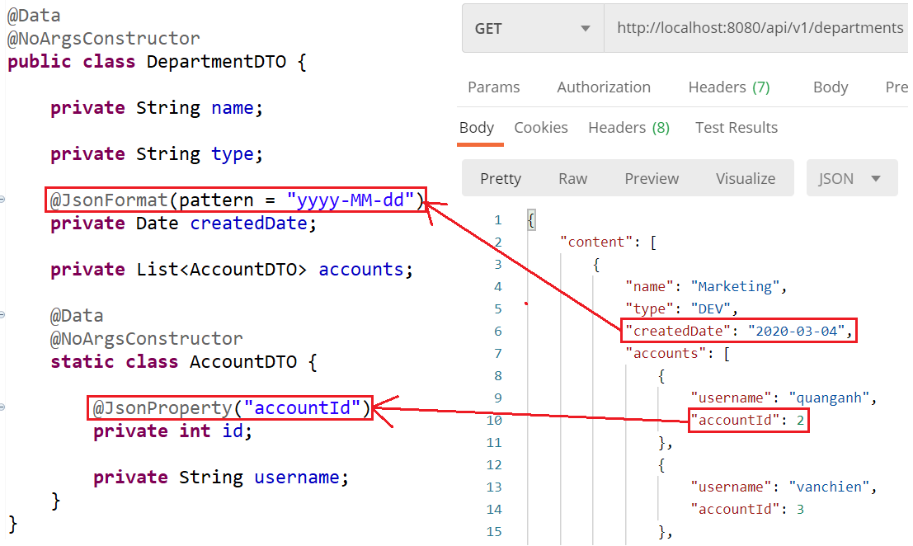
ModelMapper
Formatting DTO
Date & Rename

Slide 18
Testing System Assignments
Self-practice

Slide 19
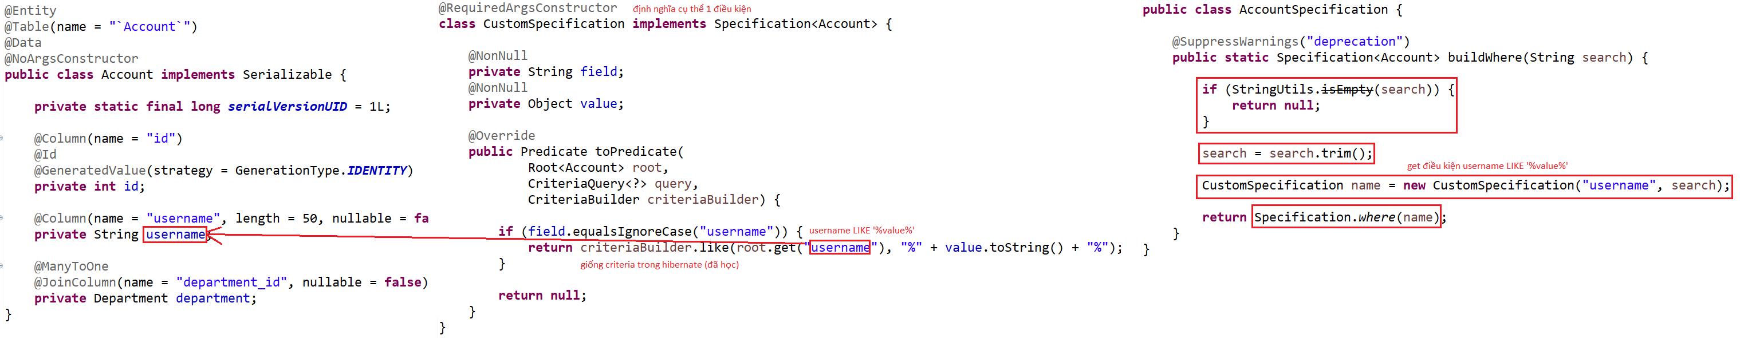
Spring Data
Specification
Used to build where conditions for the query
Example 1: 1 condition
Entity & Specification
WHERE username LIKE ‘‘%value%

Slide 20
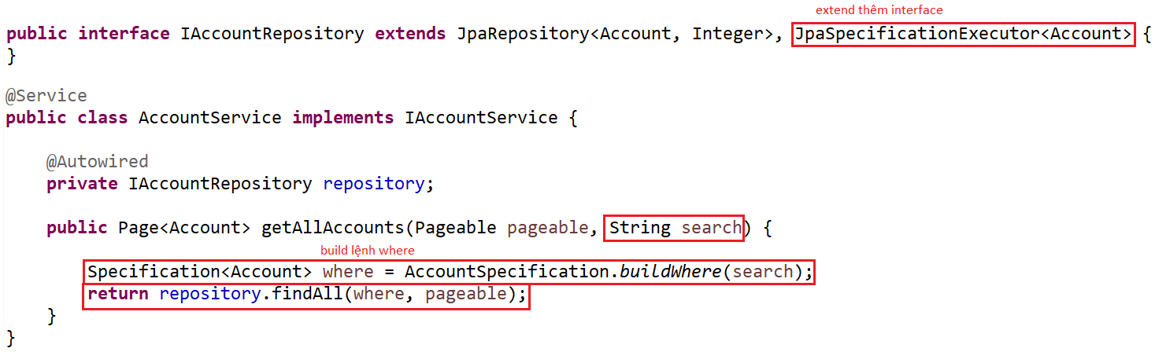
Spring Data
Repository & Service

Slide 21
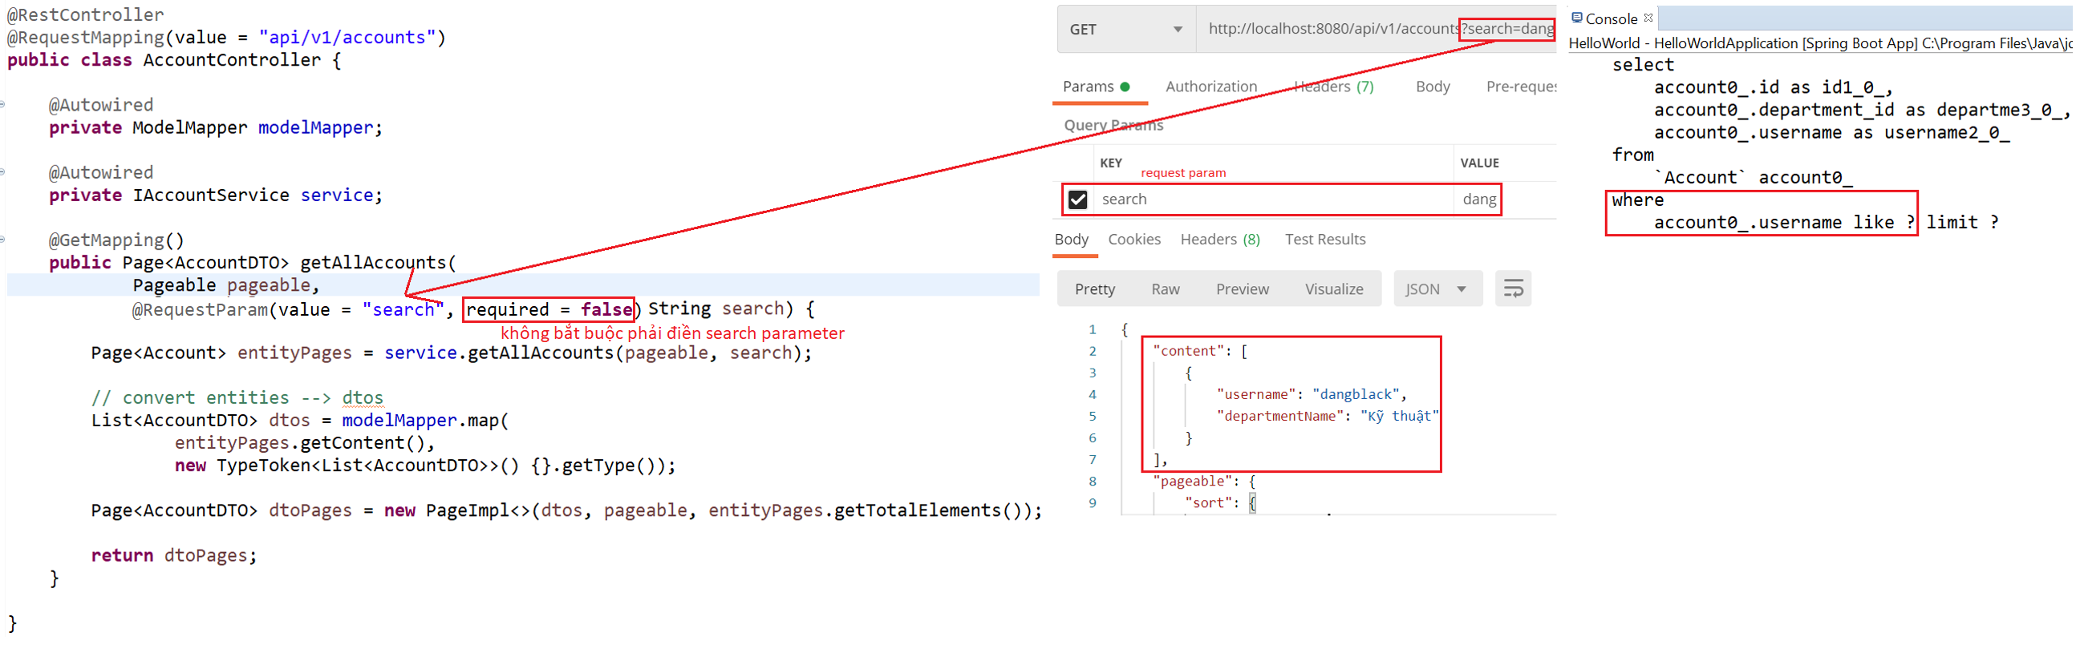
Spring Data
Controller & Test

Slide 22
Testing System Assignments
Self-practice

Slide 23
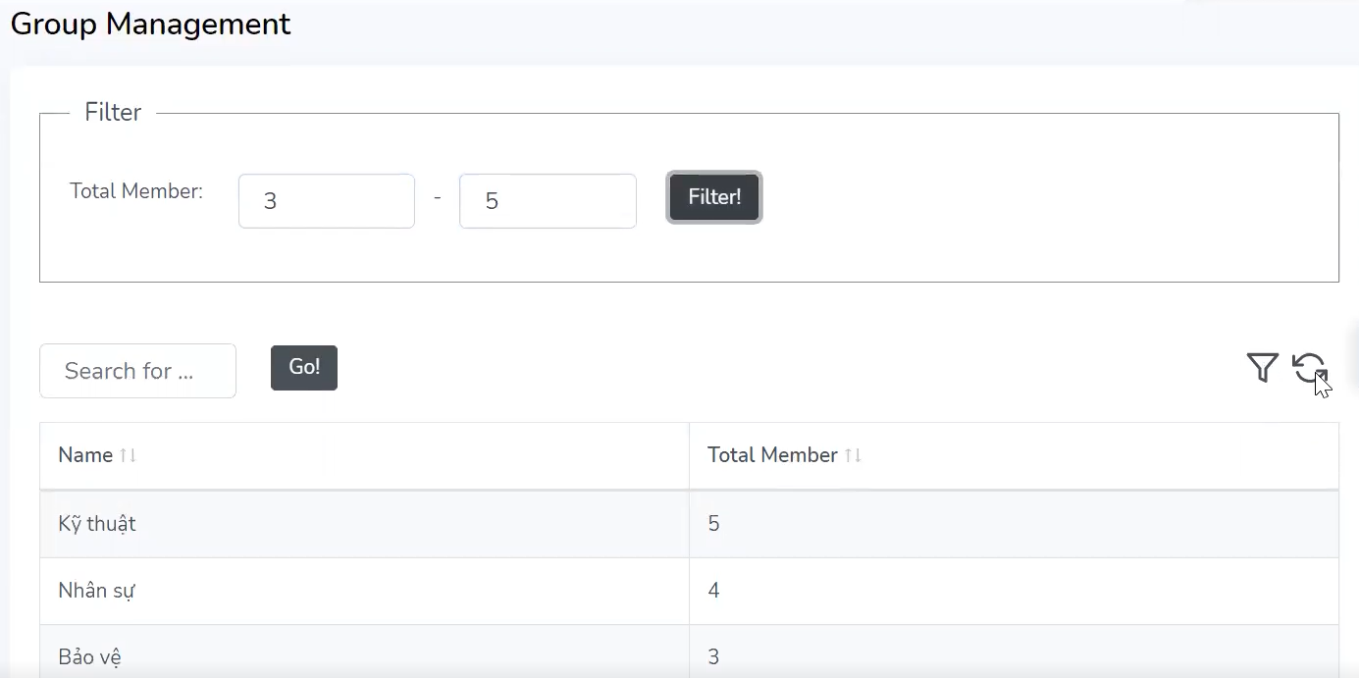
Spring Data
Example 2: multiple condition

Slide 24
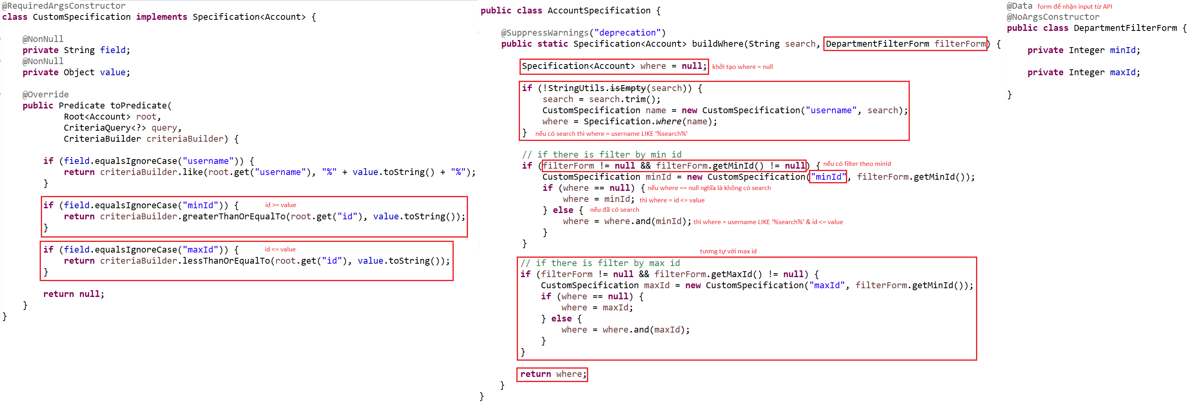
Spring Data
Specification

Slide 25
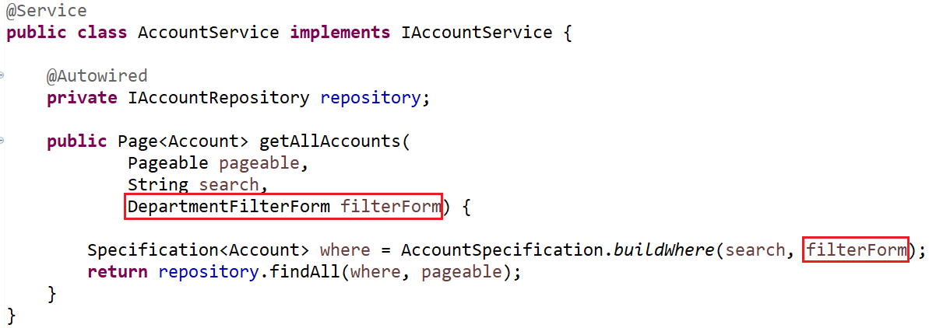
Spring Data
Service

Slide 26
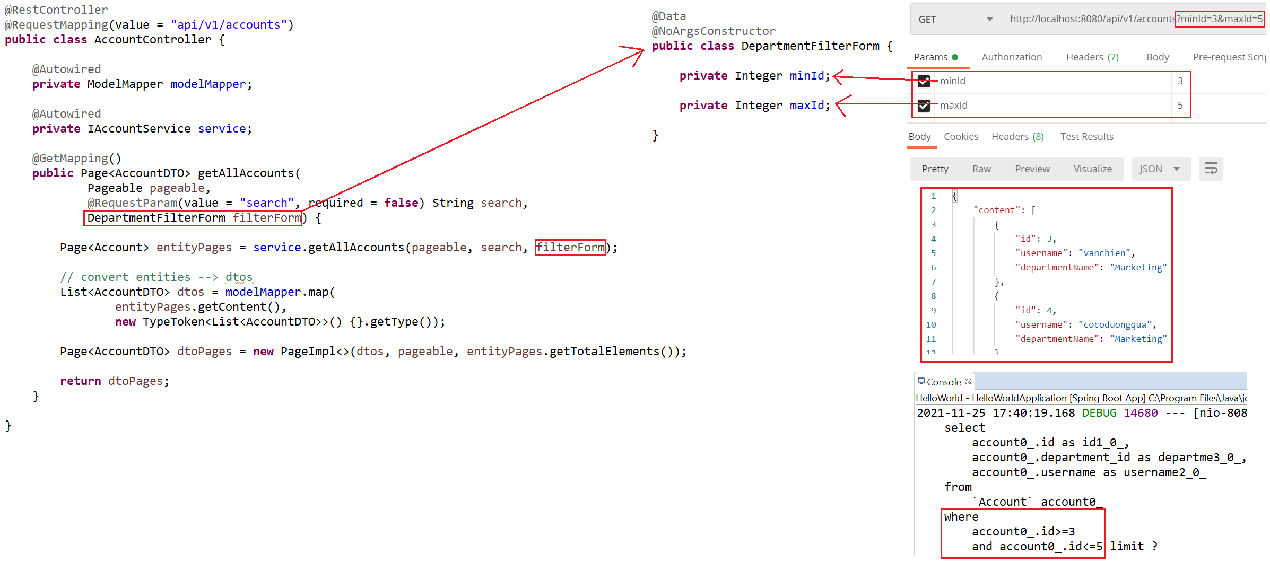
Spring Data
Test

Slide 27
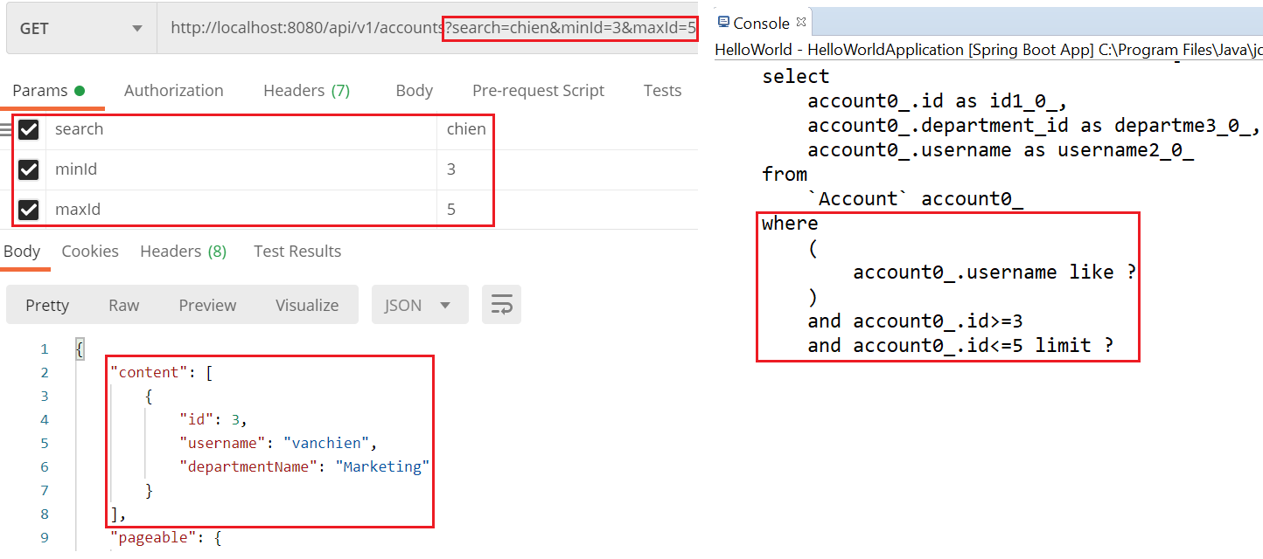
Spring Data
Test

Slide 28
Testing System Assignments
Self-practice

Slide 29
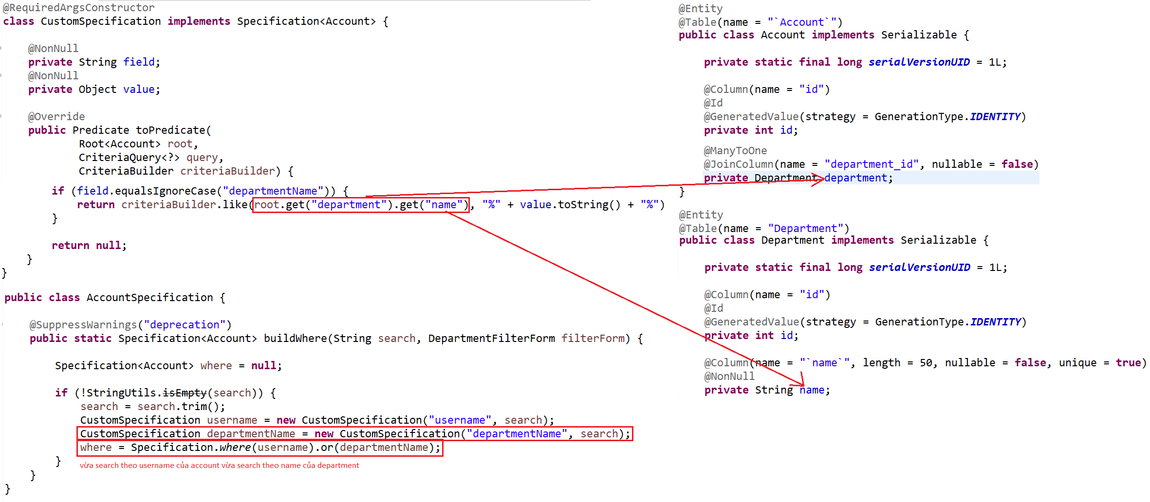
Spring Data
Example 3: Nested Attribute
Object
Specification & Entity

Slide 30
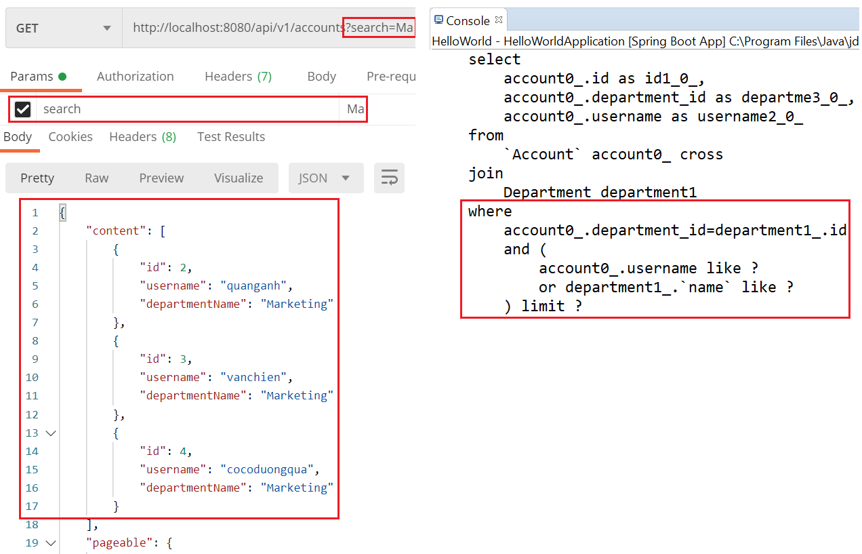
Spring Data
Test

Slide 31
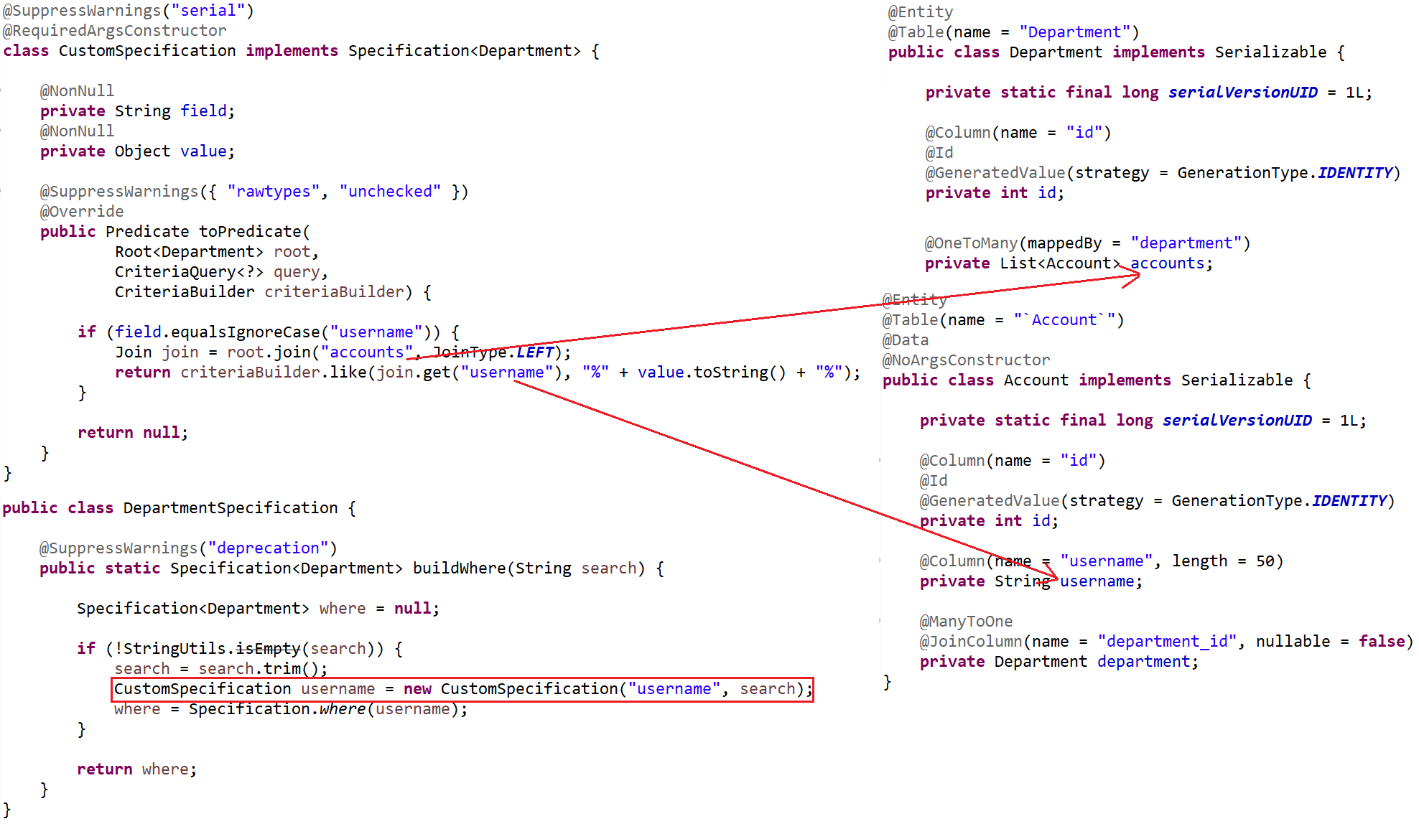
Spring Data
List
Specification & Entity

Slide 32
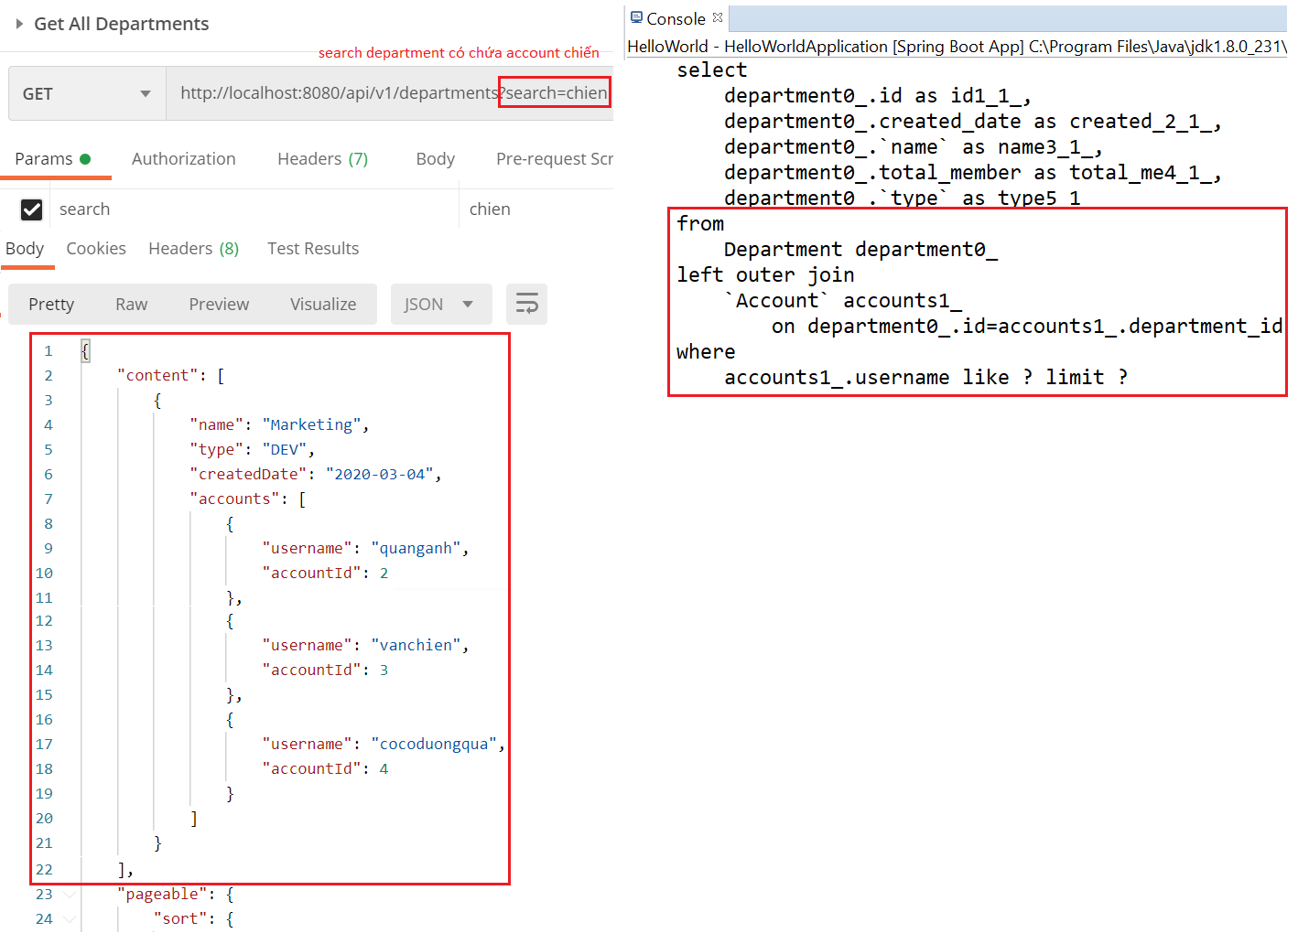
Spring Data
Test

Slide 33
Testing System Assignments
Self-practice

Slide 34
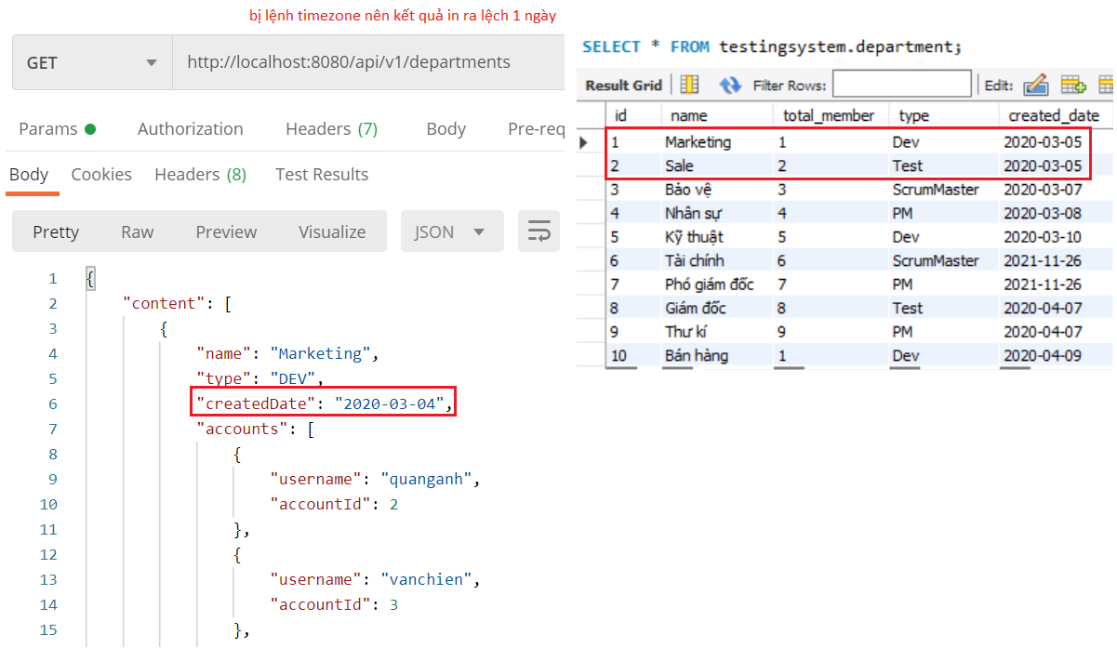
Spring Data
Example 4: Date
Problem

Slide 35
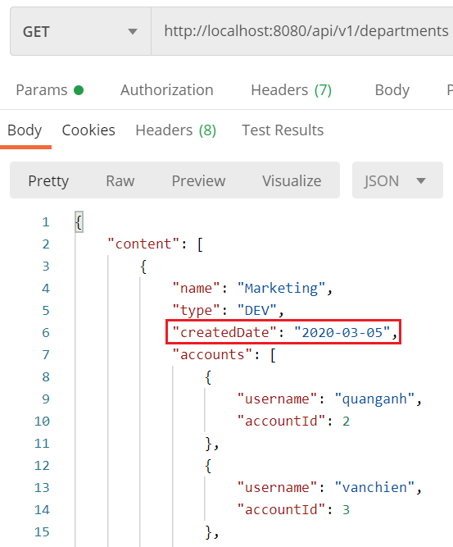
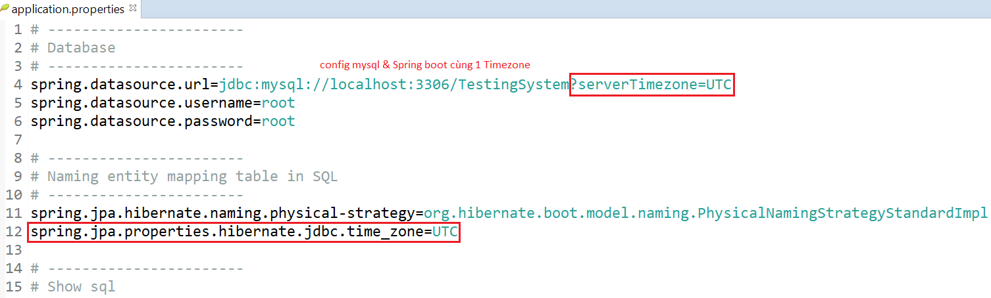
Spring Data
Fix

Slide 36
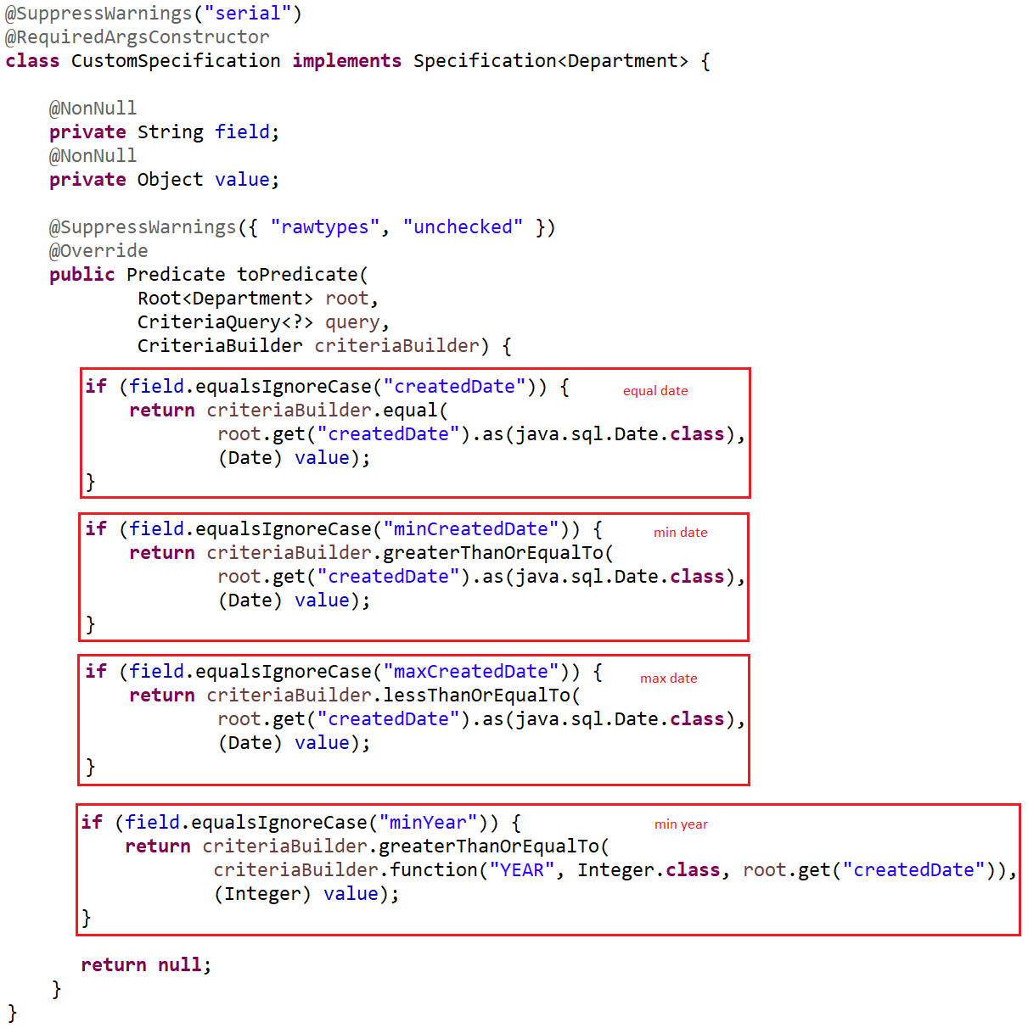
Spring Data
Compare Date: Equal Date, MinDate, MaxDate, MinYear, ...
Specification

Slide 37
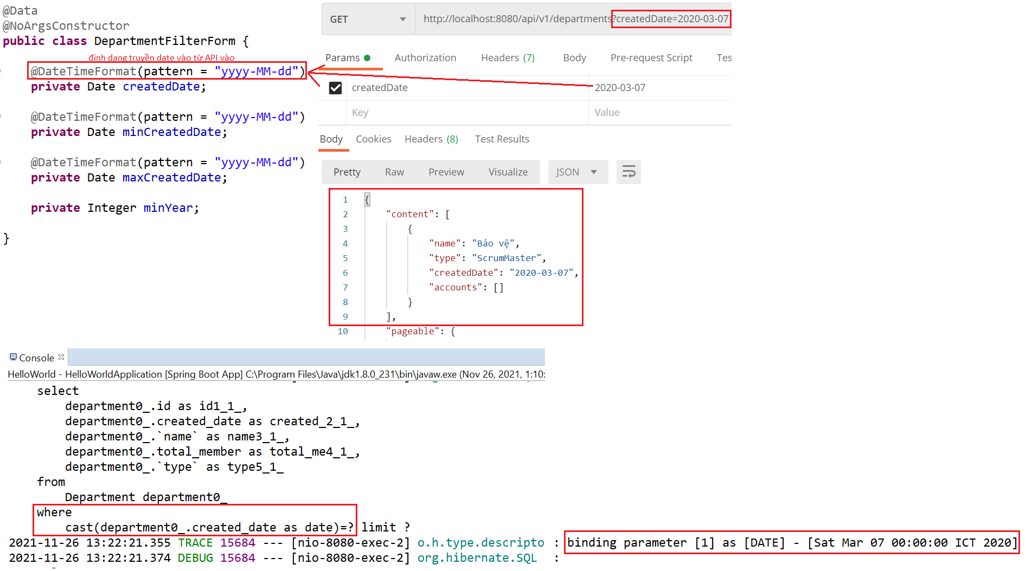
Spring Data
Test equal Date

Slide 38
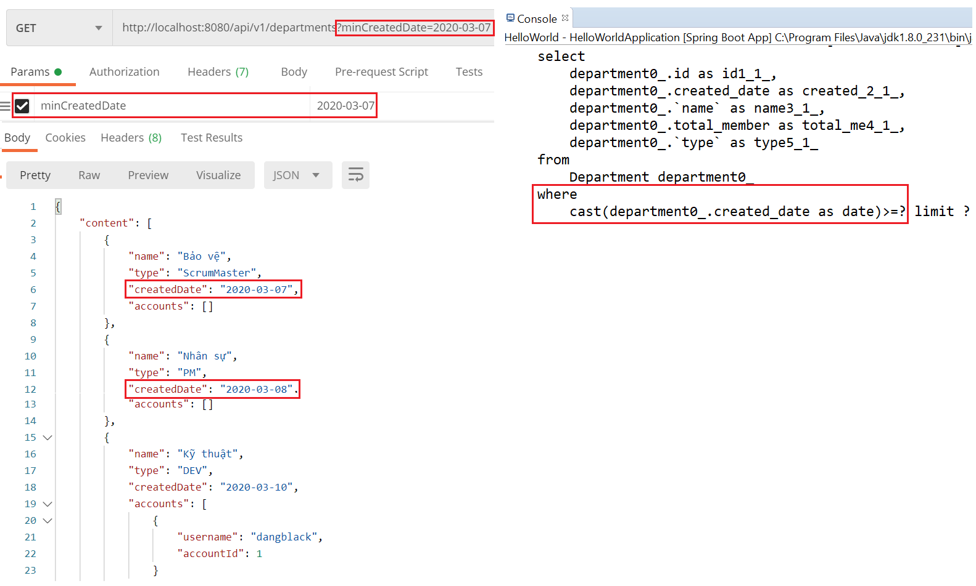
Spring Data
Test min & max Date

Slide 39
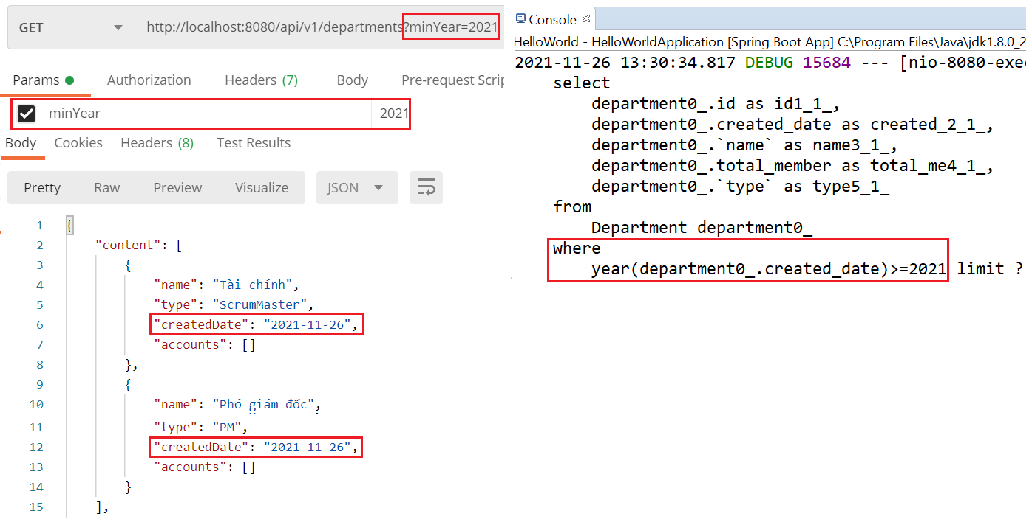
Spring Data
Test min year

Slide 40
Testing System Assignments
Self-practice

Slide 41
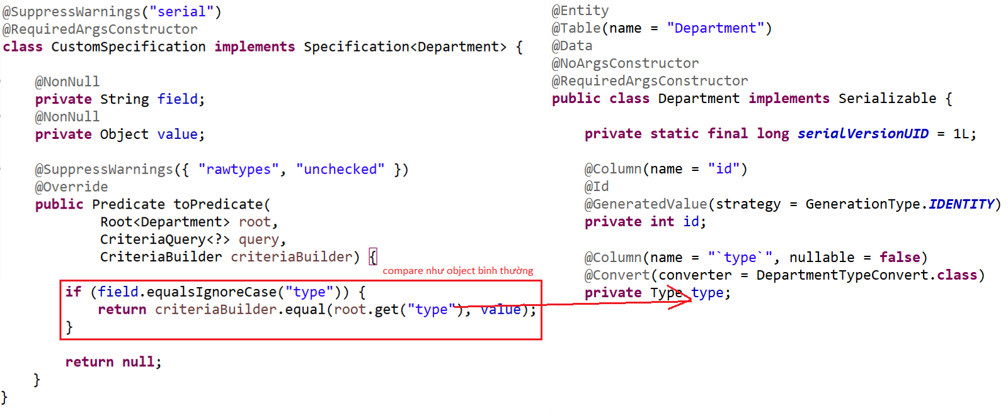
Spring Data
Example 5: Enum
Specification & Entity

Slide 42
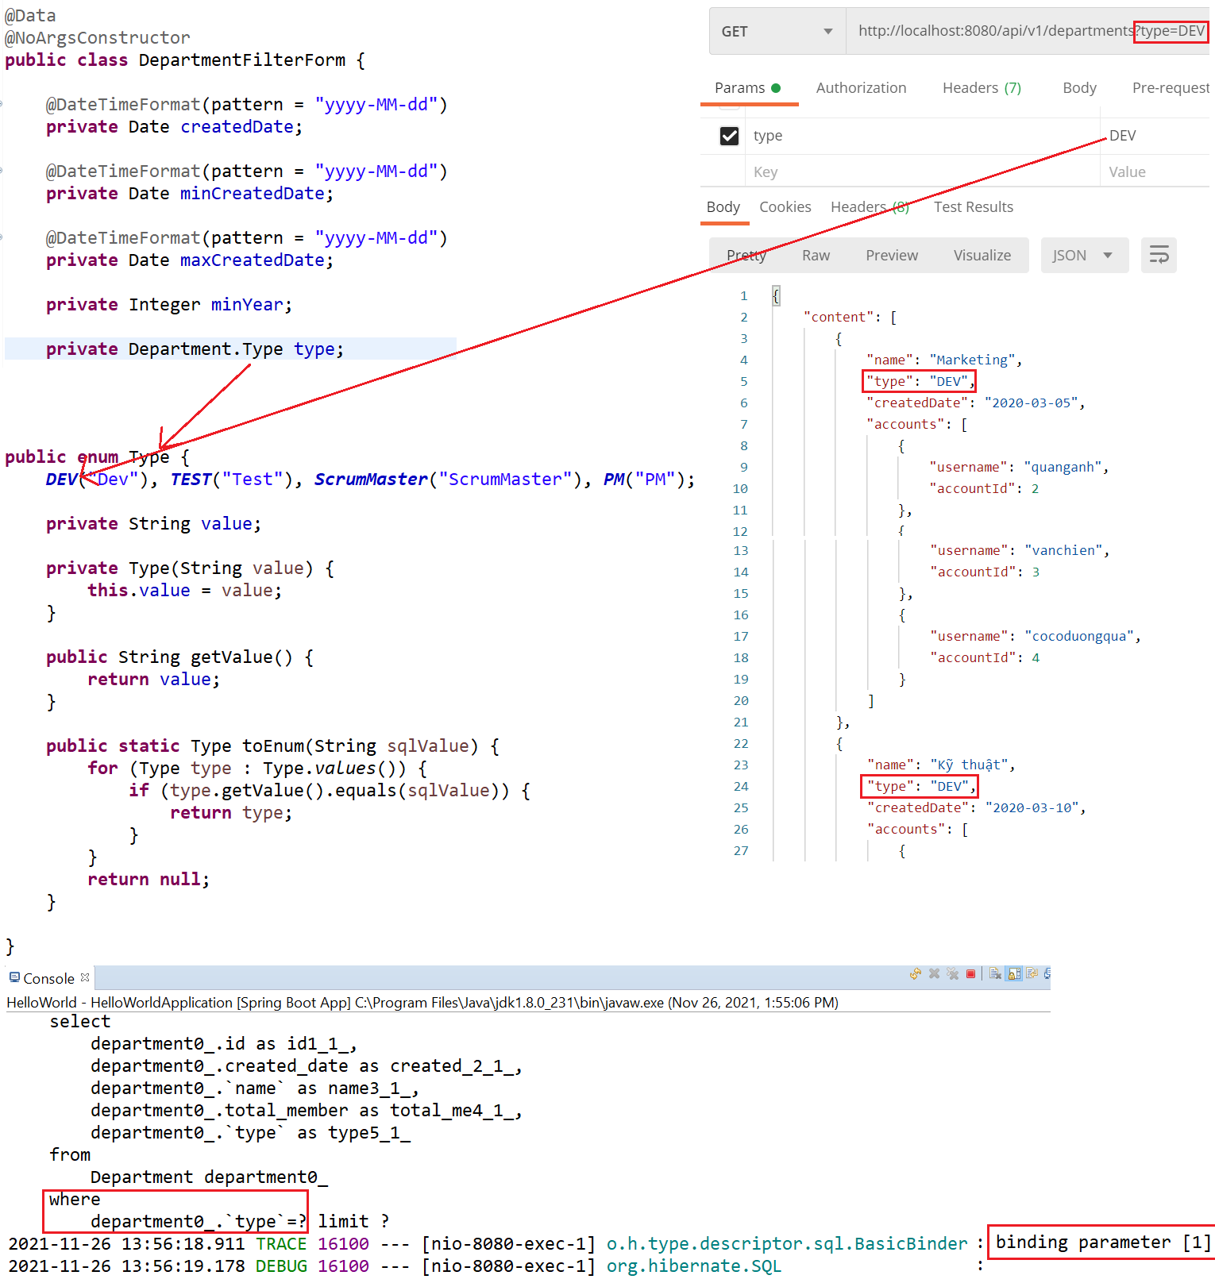
Spring Data
Test

Slide 43
Testing System Assignments
Self-practice

Slide 44
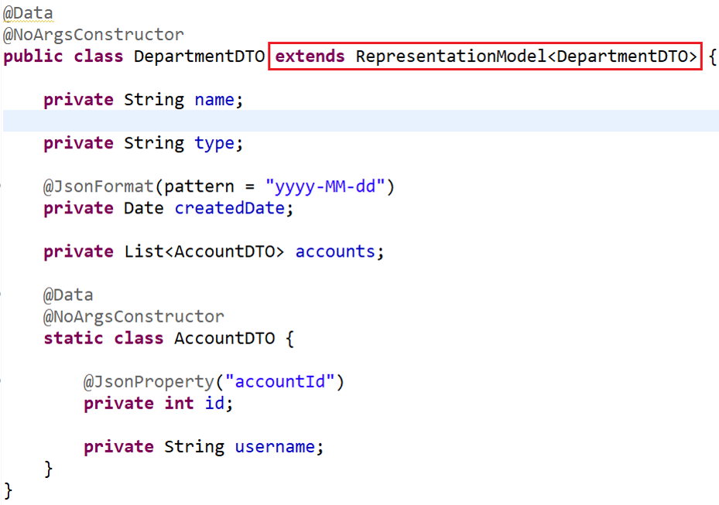
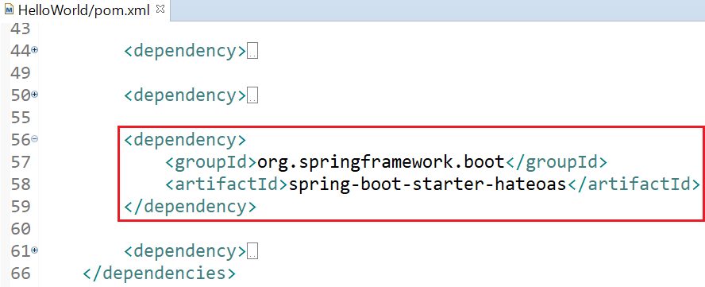
HATEOAS
Providing extra information for API
Example 1:
Pom.xml & DTO

Slide 45
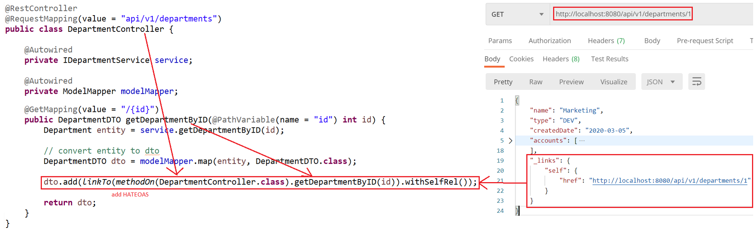
HATEOAS
Controller & Test

Slide 46
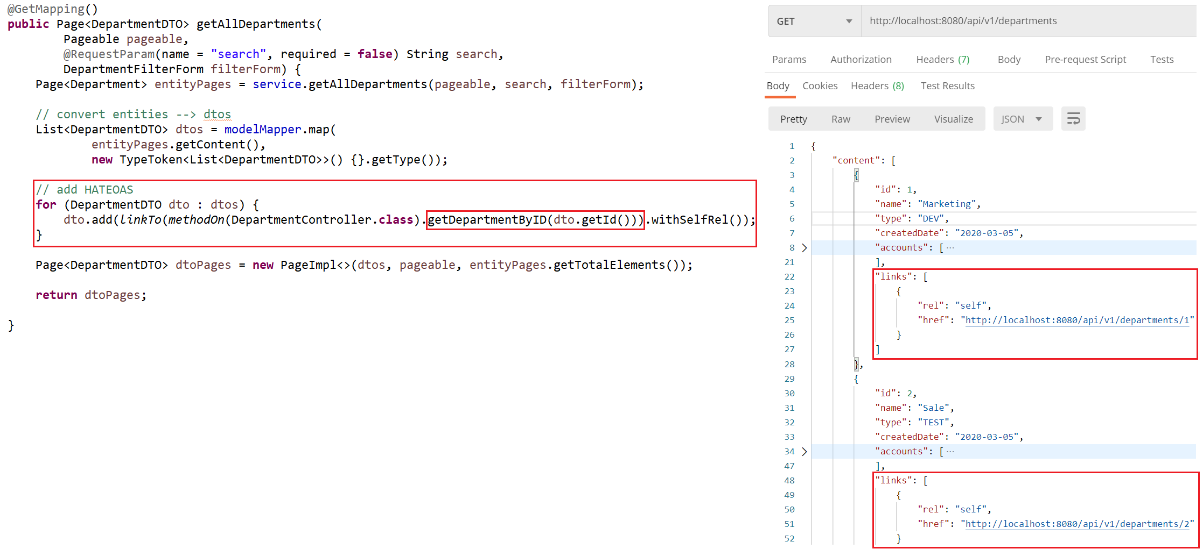
HATEOAS
Example 2:

Slide 47
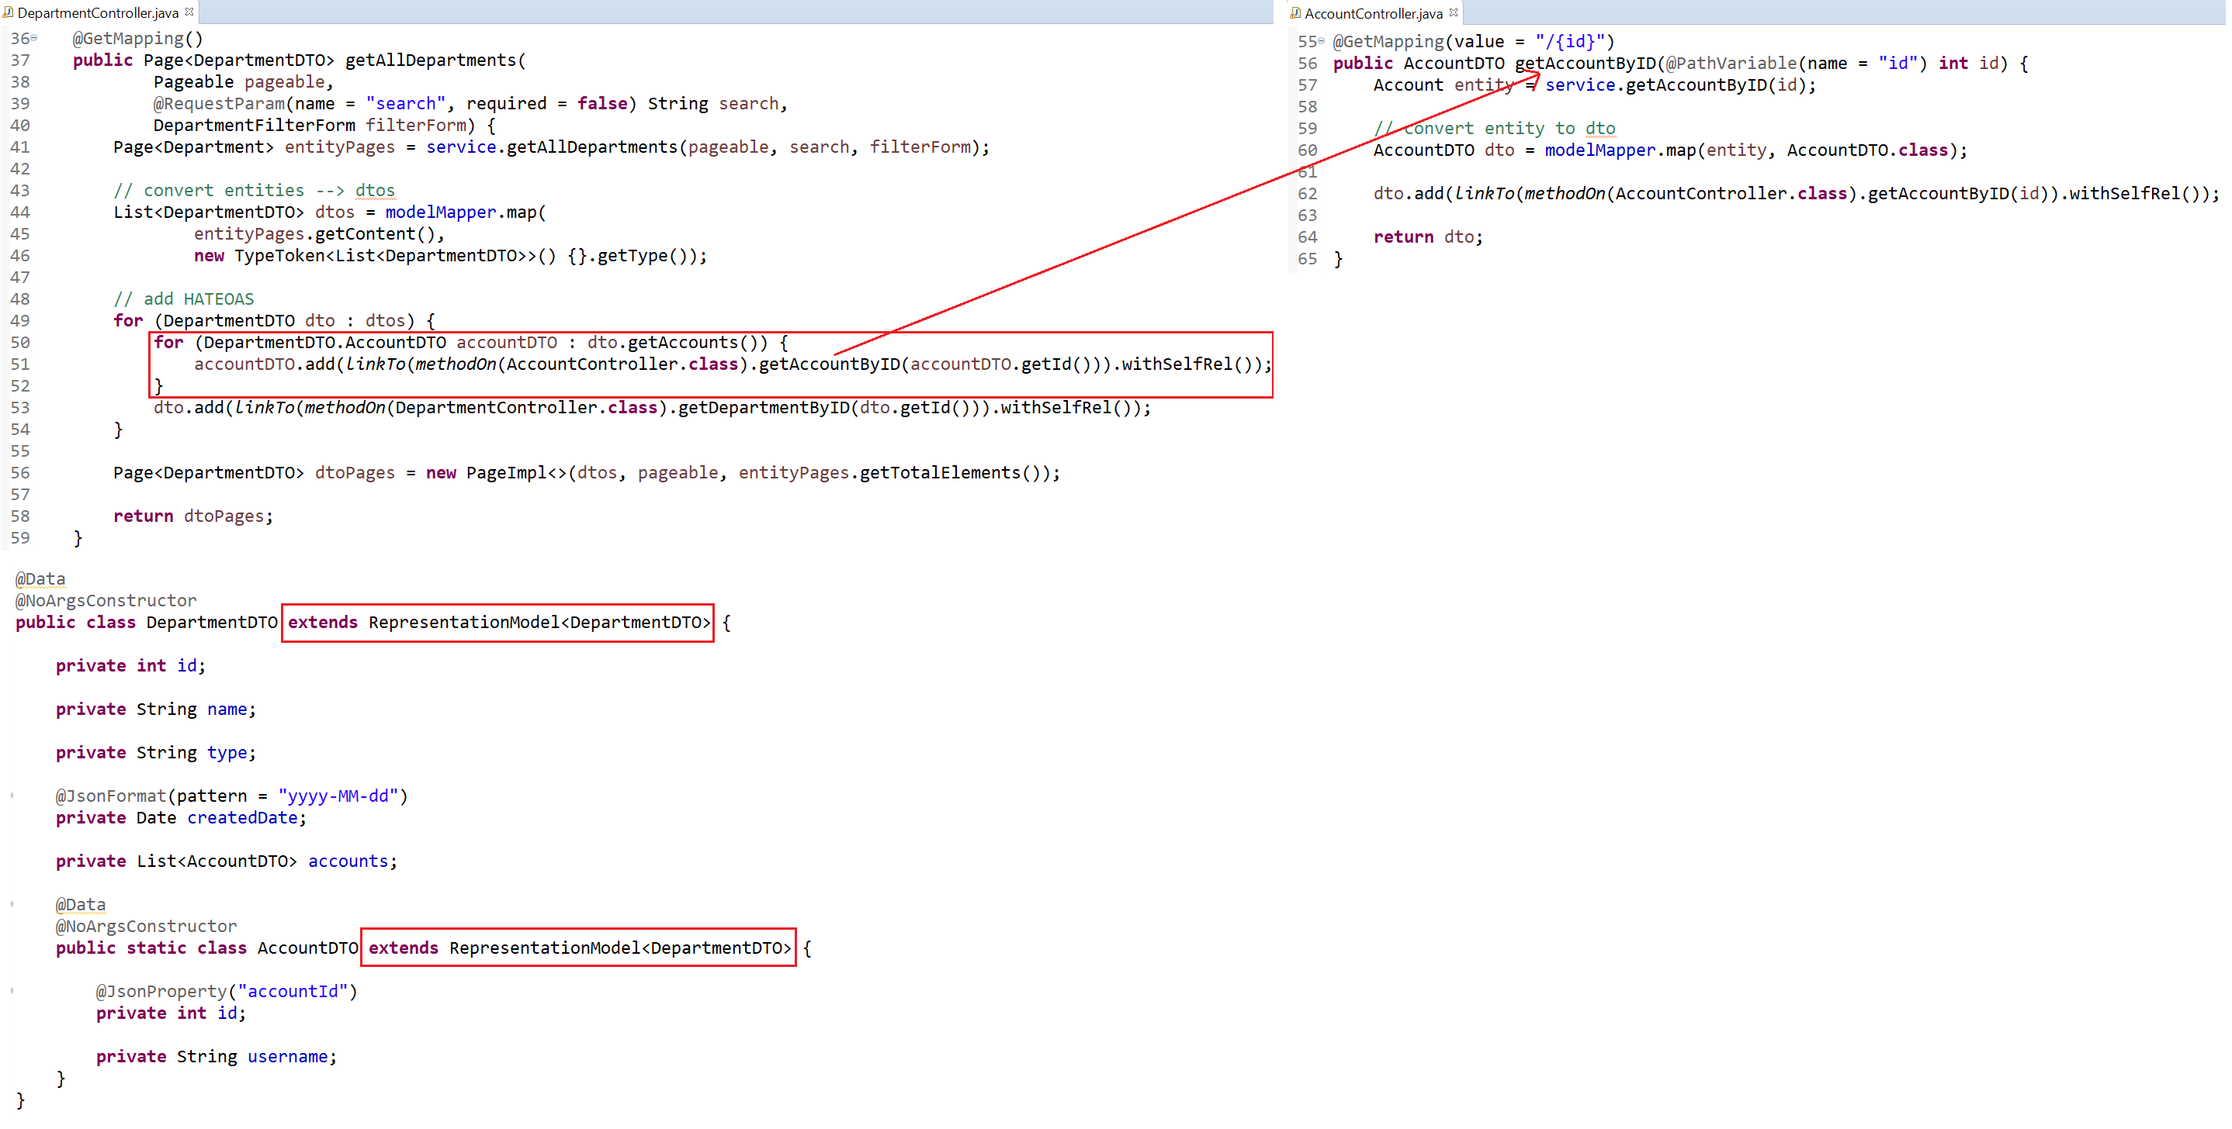
HATEOAS
Example 3:

Slide 48
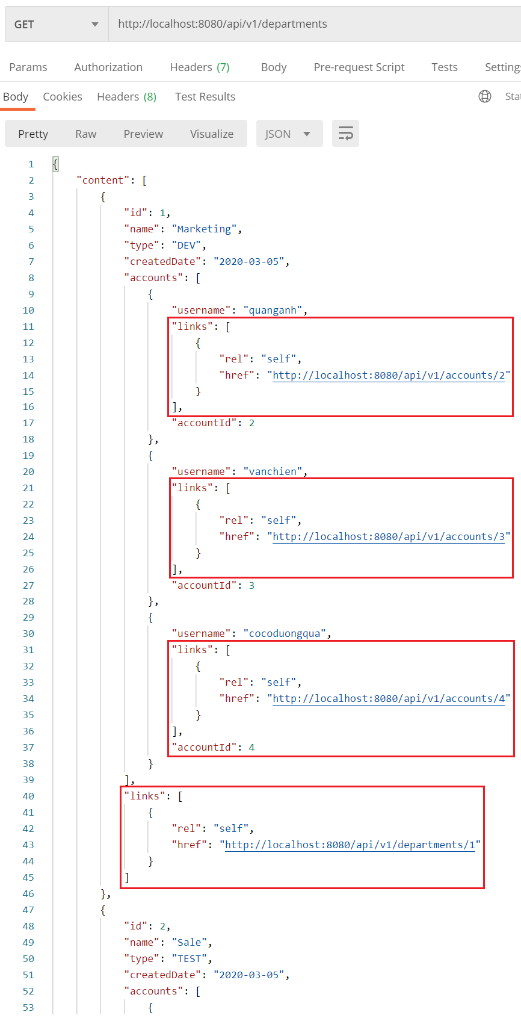
HATEOAS

Slide 49
Testing System Assignments
Self-practice

Slide 50
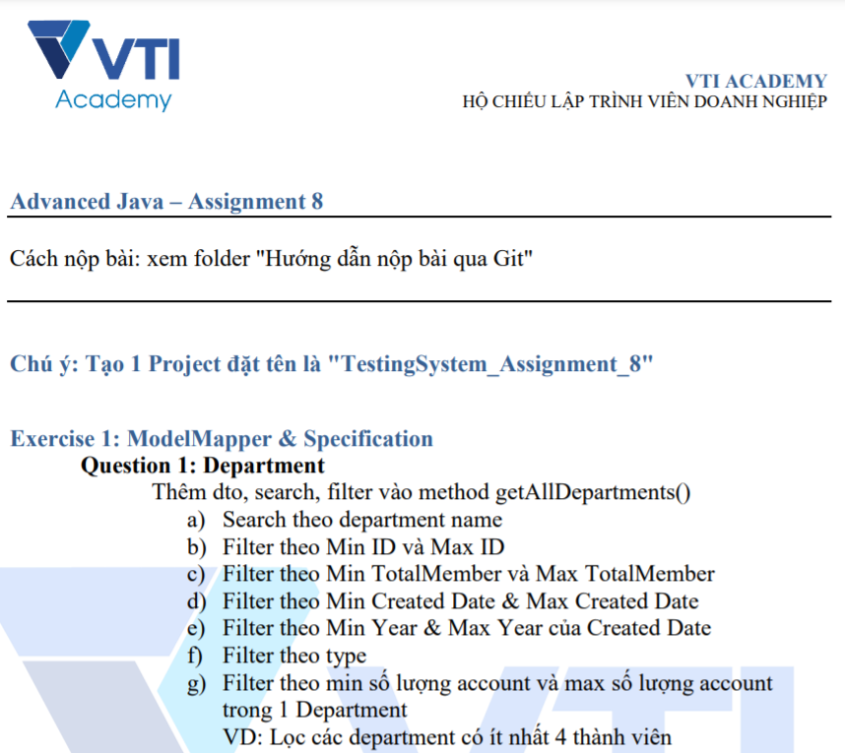
Testing System Assignments

Slide 51
Reference
https://www.baeldung.com
https://spring.io/projects/spring-boot
https://spring.io/guides#getting-started-guides

Slide 52
Q & A
Copyright © VTI Academy All Rights Reserved

